Slide 1


TubeNxt
Fake TC Prevention Solution
Notes:
Change logo

Slide 2
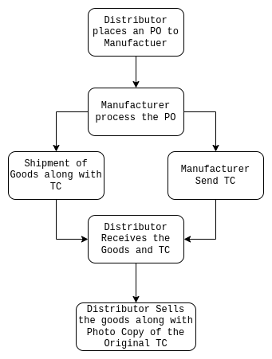
As-Is Process
1. Distributor places a purchase order to the manufacturer
2. Manufacturer process the order
3. Manufacturer send the Goods and Physical copy of the TC to the Distributor
4. Distributor sells the goods along with PhotoStated copy of the Original TC

Slide 3
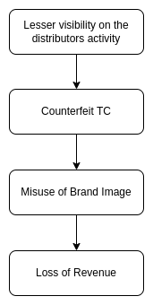
Shortcomings of As-Is Process
1. There are no visibility after shipment of the goods
2. Chances to use the brand image along with using Counterfeit TC and Goods
3. Thread on brand image reputation
4. Revenue loss due to misuse of brand image and fulfilling the demand with fake products

Slide 4
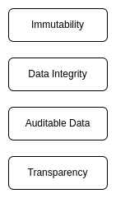
Solution to Current Problems
Core Features of Blockchain
Digitize TC Issuance
Digital Signature
Digitization of TC Issuance makes it more faster and reliable
Digital signatures on TCs can be used to validate the authenticity of the TC and invalidating physical copy of the TC
Transparency
Data Integrity
Transactions of a TC need to be transparent to the Customers and Consumers
TC data needs to be tamper proof to maintain the reliability, trustworthiness and the brand image

Slide 5
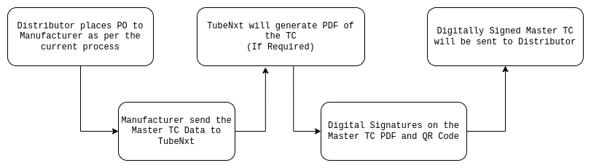
Digital TC Issuance Process
Digitize TC Issuance
Digital Signature
Digitization of TC Issuance makes it more faster and reliable
Digital signatures on TCs can be used to validate the authenticity of the TC and invalidating physical copy of the TC
* Digitally signed Test Certificates can be viewed from the platform
* Digitally signed Test Certificates can be sent over email

Slide 6
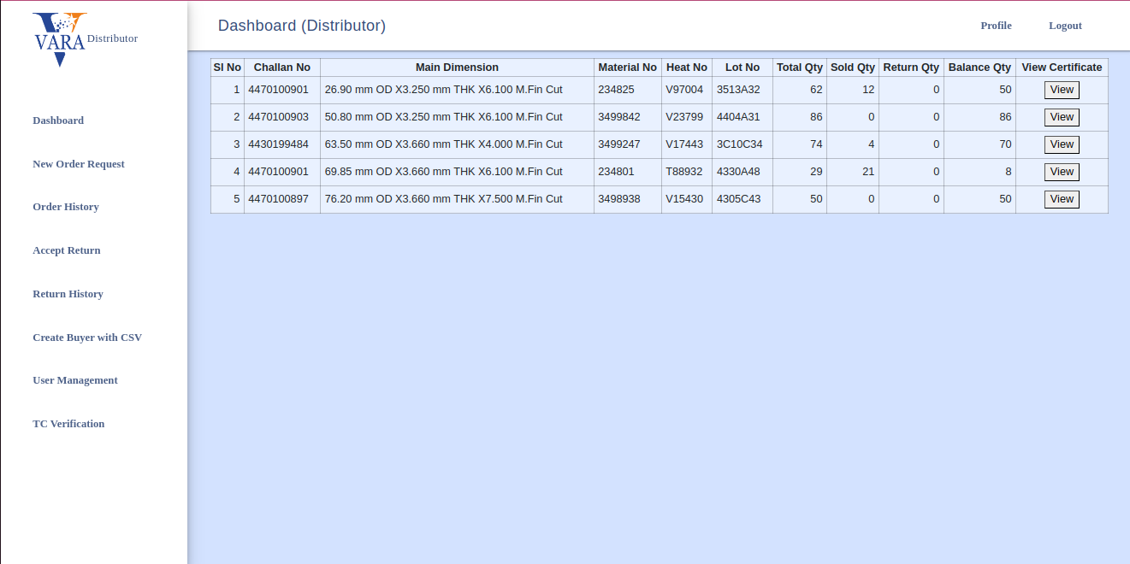
View Digital TC - Step 1
Digitize TC Issuance
Digital Signature
Digitization of TC Issuance makes it more faster and reliable
Digital signatures on TCs can be used to validate the authenticity of the TC and invalidating physical copy of the TC

Slide 7
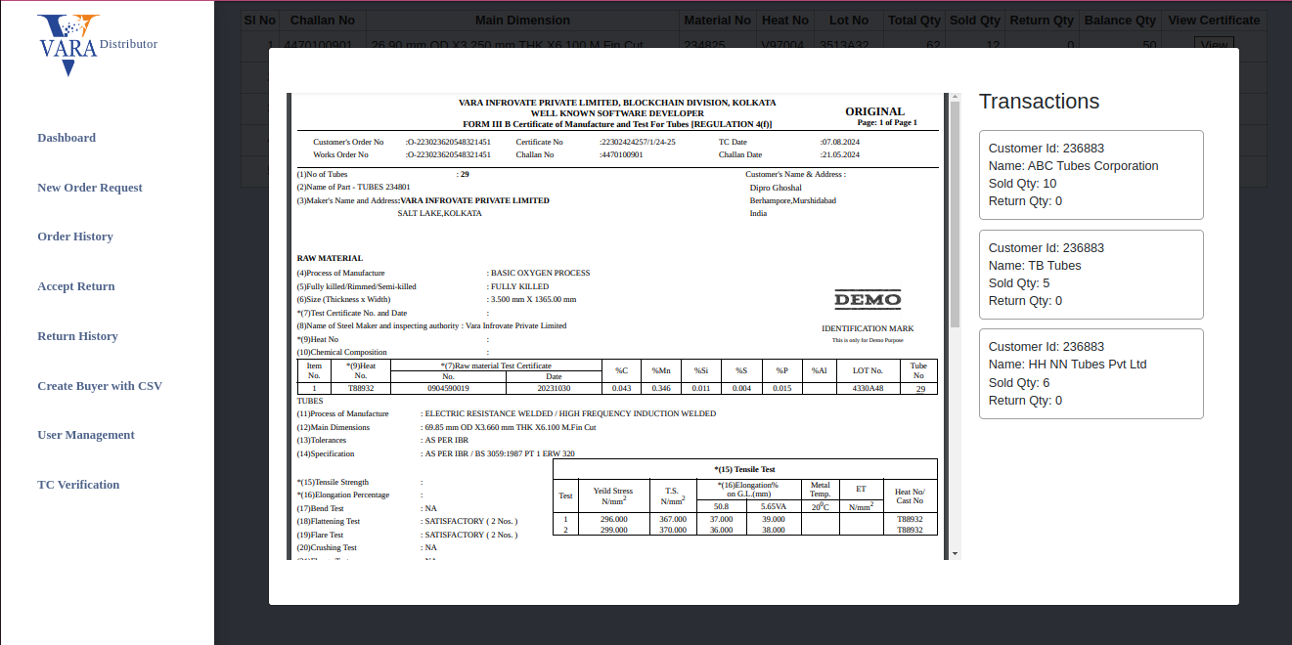
View Digital TC - Step 2
Digitize TC Issuance
Digital Signature
Digitization of TC Issuance makes it more faster and reliable
Digital signatures on TCs can be used to validate the authenticity of the TC and invalidating physical copy of the TC

Slide 8
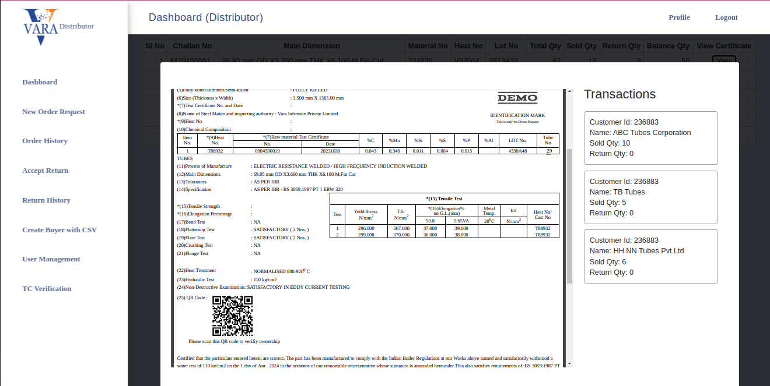
View Digital TC - Step 2 - After scrolling down
Digitize TC Issuance
Digital Signature
Digitization of TC Issuance makes it more faster and reliable
Digital signatures on TCs can be used to validate the authenticity of the TC and invalidating physical copy of the TC

Slide 9
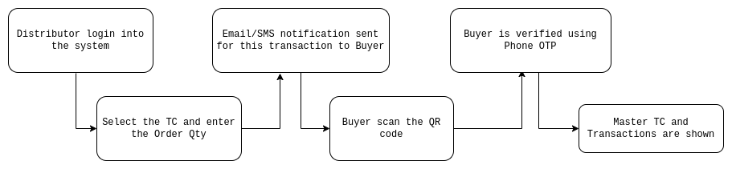
Digital TC Issuance Process
Digitize TC Issuance
Digital Signature
Digitization of TC Issuance makes it more faster and reliable
Digital signatures on TCs can be used to validate the authenticity of the TC and invalidating physical copy of the TC
1. Distributor (Seller) logs a transaction of gods quantity into the platform
2. Buyer gets notification over Email/SMS
3. Buyer scans the QR Code
Seller can provide the printout of the original TC which has the QR code
Ownership of the TC is not proven without the platform confirmation
4. Buyer authenticate to view the TC
5. View the TC and Transactions

Slide 10
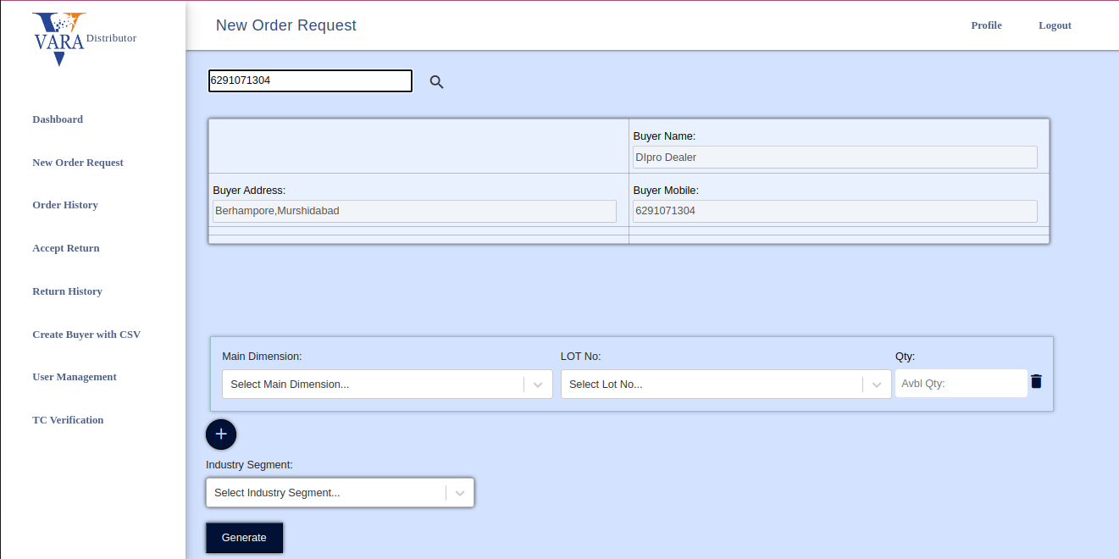
TC Verification from Platform - Step 1
Enter the buyer details
Digitize TC Issuance
Digital Signature
Digitization of TC Issuance makes it more faster and reliable
Digital signatures on TCs can be used to validate the authenticity of the TC and invalidating physical copy of the TC

Slide 11
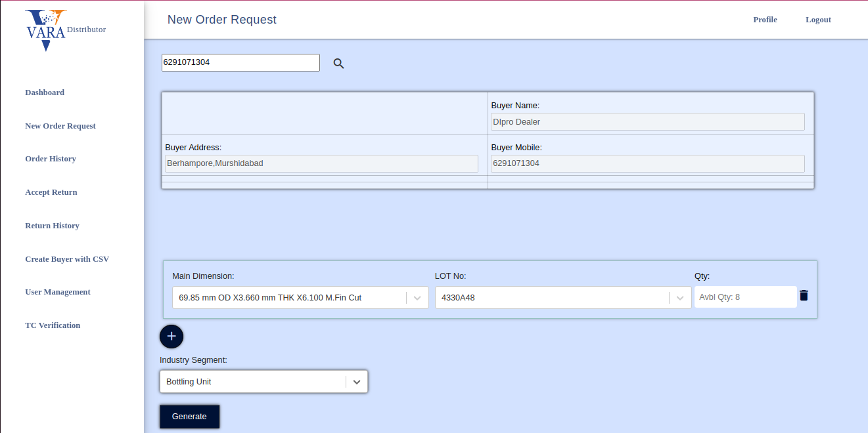
TC Verification from Platform - Step 2
Enter the product details
Digitize TC Issuance
Digital Signature
Digitization of TC Issuance makes it more faster and reliable
Digital signatures on TCs can be used to validate the authenticity of the TC and invalidating physical copy of the TC

Slide 12
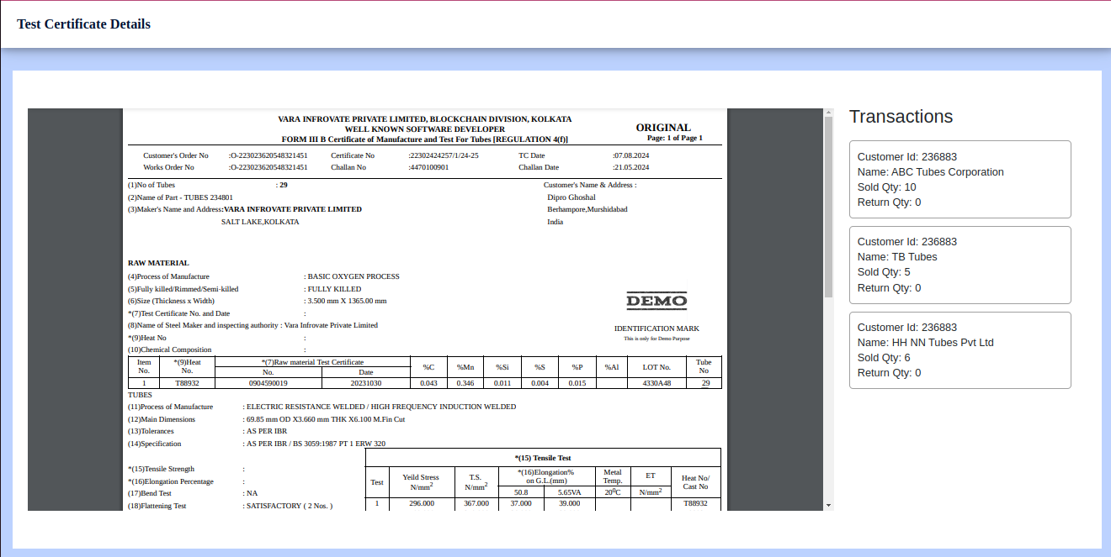
TC Verification from Platform - Step 3
View the TC and Transactions after OTP Authentication
Digitize TC Issuance
Digital Signature
Digitization of TC Issuance makes it more faster and reliable
Digital signatures on TCs can be used to validate the authenticity of the TC and invalidating physical copy of the TC

Slide 13

THANK YOU
MUMBAI | GURUGRAM | KOLKATA
Follow us
www.varatechnology.com

